Slide 1


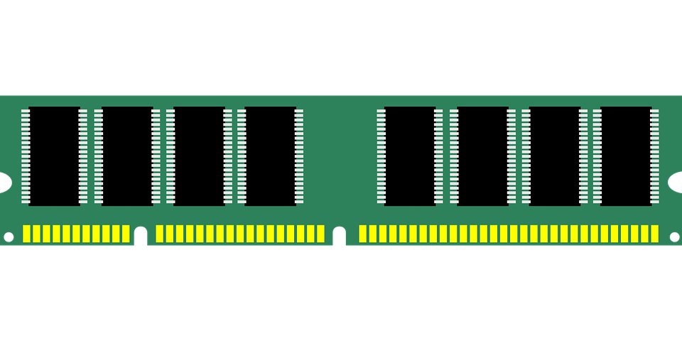





PT-Guard: Integrity-Protected Page Tables to
Defend Against Breakthrough Rowhammer Attacks
Anish Saxena†, Gururaj Saileshwar†#, Jonas Juffinger ‡,
Andreas Kogler ‡, Daniel Gruss ‡, Moinuddin Qureshi†
†Georgia Institute of Technology, USA
#NVIDIA Research, USA
‡Graz University of Technology, Austria
Notes:
Good afternoon everyone, I am Anish Saxena, a second year PhD student at Georgia Institute of Technology advised by Prof. Moinuddin Qureshi
I am pleased to present PT-Guard, our solution to protect page table integrity against breakthrough Rowhammer attacks.
This work was done in collaboration with Gururaj, an alumni of our research group, and Jonas and Andreas from Daniel Gruss’ group at TU Graz.

Slide 2
Outline for the talk
Rowhammer and breakthrough attacks
Privilege escalation and limitations of current defenses
PT-Guard: MAC-based integrity protection
Evaluation and optimizations to reduce overheads
Best-effort error correction capability
Conclusions
Notes:
Here’s the outline for today
I will first discuss Rowhammer and privilege escalation attacks, and look at shortcomings of current defenses.
Then, I will describe PT-Guard, its performance overheads and some optimizations to reduce those overheads.
Finally, I will talk about the error correction capability of PT-Guard and conclude the talk.
So let’s get started

Slide 3



Rowhammer
Victim Row
1 1 1 1 1 1 1 1 1 1
1 1 0 1 1 1 0 1 1 1
Aggressor Row
0 0 0 0 0 0 0 0 0 0
Victim Row
1 1 1 1 1 1 0 0 0 1
1 1 1 1 1 1 1 1 1 1
Rowhammer attacks break integrity, confidentiality and privilege boundaries
Notes:
Rowhammer occurs when an aggressor row is accessed frequently causing bit flips in nearby victim rows.
The attack requires activating the same row frequently, which can be done in only a few instructions as shown here, by alternatively activating two different rows.
Rowhammer has become a severe security threat due to the simplicity of the attack and has been shown to corrupt data, break confidential guarantees, and privilege boundaries.

Slide 4
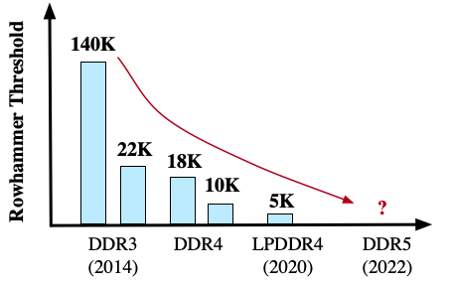
Rowhammer is getting worse
We need principled defenses that tackle future DRAM devices with unpredictable vulnerability
Notes:
The number and location of bit flips observed depends on several factors.
Alternatively targeting two rows is known as double-sided Rowhammer, while other methods such a one-location Rowhammer can be used, for example, with closed page policies.
The Rowhammer threshold is the minimum number of activations to any row that cause bit flips in nearby rows.
This threshold has reduced drastically by 30X over the past 8 years and we can expect even lower threshold in the future.
Moreover, as node sizes shrink, the interference between DRAM bit cells, which causes Rowhammer, is also increasing.
So, solutions that defend against Rowhammer must not only work at current DRAM vulnerability, but also against future DRAM generations with much lower thresholds.

Slide 5



Rowhammer protection
Mitigative Action
Victim
Victim
Access
Tracker
Aggressor
T
Victim
Victim
Memory Controller
DRAM
Commercial Rowhammer defenses track aggressor rows and refresh victims
Notes:
Typical solutions for Rowhammer consists of two parts- tracking the number of accesses to each row and performing mitigative action on aggressors
Once an aggressor is identified, the typical mitigation involves refreshing the victim rows to prevent Rowhammer
Industry has deployed this defense, dubbed TRR, and it can be found in DDR4 modules.

Slide 6
the half-double breakthrough attack
Mitigative Action
Distance-of-2
Victim
Access
Tracker
Aggressor
T
Victim
Distance-of-2
Memory Controller
DRAM
Half-Double is a breakthrough attack that breaks all commercial defenses
Notes:
Unfortunately, attackers continue to develop novel access patterns that defeat such existing mitigations
For example, the recently disclosed Half-Double attack from Google leverages the victim refresh itself to attack
Half Double induces so many victim refreshes in the nearby rows that it causes bit flips in neighbors at a distance-of-2
This breakthrough attack breaks all commercial and proposed mitigations that rely on victim refresh

Slide 7
Shortcomings of proposed defenses
0
Assumptions
Tracker
Mitigative action
T
↓↓
Tracker
T
Victim
Victim
Aggressor
Rowhammer defense
Despite mitigations, systems remain vulnerable to breakthrough Rowhammer attacks
Notes:
Recent defenses proposed by academia are more principled, with guaranteed tracking of all aggressors and secure mitigative actions.
These defenses are resilient to the Half-Double attack.
However, in addition to the attacker’s threat model, such defenses assume a model of the Rowhammer vulnerability as well.
If the vulnerability model differs from what is observed on real devices, the defenses break down.
For example, if the threshold on future modules decreases by more than what the tracker is designed for, an aggressor may escape detection.
As breakthrough attacks exploit limitations of these defenses, no current defense provides guaranteed protection against Rowhammer.
And the system remains vulnerable to breakthrough attacks despite the presence of mitigations.

Slide 8
Privilege escalation with rowhammer
PFN
Flags
Aggressor
PFN
Flags
Attacker’s page table
Attacker accessible page
Attacker inaccessible page
DRAM
Tampering with page tables enables privilege escalation attacks, breaking system security
Notes:
While complete protection against Rowhammer is difficult to achieve, targeted defenses have come up to protect the most critical targets.
To this end, the most severe Rowhammer exploit is to tamper with page tables for privilege escalation.
To achieve this, the attacker first sprays the memory with its own page table pages by requesting a lot of memory.
Then, the attacker induces bit flips on its own page tables.
A flip in the PFN field of the PTE makes the attacker’s virtual page point to a different physical page.
Now, as the attacker has filled the memory with its own page table pages, there is a possibility the PTE now points to the attacker’s page table.
Thus, the attacker can now modify its own page tables to access any physical page in memory, which is equivalent to kernel privilege.

Slide 9
Limitations of page table defenses
10
Flags
PFN | Prot. Key | U/S | WR | NX | P
00
Page Table Entry (PTE)
Page tables
Kernel pages
User pages
DRAM
Monotonic Pointers [ASPLOS’19]
Page table defenses do not provide complete protection for all PTE fields
Notes:
Ideally, we want to protect the critical page tables in the presence of known and unknown breakthrough attacks.
Unfortunately, page table defense also do not provide full coverage.
For example, monotonic pointers leverage the unidirectional nature of bit flips to ensure that bit flips in PFNs cannot make the PFN point to a page table page, protecting against privilege escalation.
However, modern page table entries contain several metadata bits.
Monotonic pointers protect only the PFN field, but flipping the no-execute bit, for example, can bypass write-XOR-no-execute permission check.
Similarly, another recent defense, SecWalk, only detects up-to 4 bit flips in a 64-bit PTE, but on real devices up-to 7 bit-flips within an 8-Byte word have been observed.
Currently no defense provides sufficient protection against breakthrough attacks even for page tables.

Slide 10
Mac-based integrity protection
PFN | Metadata
Page Table Entry (PTE, 8-Bytes)
Storage
overhead
Compute MAC
PTE
…
PTE
MAC
PTE Cacheline (64-Bytes, 8 PTEs)
Store
MAC
Access
overhead
PTE
…
PTE
MAC’
== ?
MAC mismatch
MAC provides cryptographic integrity protection but has high overheads
Notes:
To provide complete protection, our defense must detect arbitrary bit flips in any field of page table, be it PFN or metadata.
We observe that message authentication codes (MAC) can detect such arbitrary tampering, so a MAC computed over all PTE fields can reliably detect any bit flips.
The computed MAC is stored in DRAM and compared against the recomputed MAC whenever the line is read back from memory, with a mismatch indicating bit flips.
Unfortunately, MACs require significant storage, for example, a 64-bit MAC is a 12.5% storage overhead and typically requires an extra memory access with every PTE cacheline access to the DRAM.
This is a significant runtime overhead.

Slide 11
Embedding mac within the pte cacheline
1-TeraByte
DRAM in typical client systems
PTE
…
28-bits
PFN | Metadata
PTE
MAC_{1/8}
0 … 0
40-bits
Maximum addressable DRAM
4-PetaBytes
PT-Guard embeds a 96-bit MAC within the PTE line, obviating storage and access overheads
Notes:
We want to rely on the security provided by a MAC while avoiding associated overheads.
To this end, we observe that while modern PTEs are provisioned with 40-bit PFNs that can address 4 petabytes of physical memory, client systems use much less.
Typically only use up-to 1 terabytes, leaving 12 bits in every PTE’s PFN unused.
Our key insight is to pool these unused PFN bits within the PTEs of a PTE cacheline to embed the MAC.
We repurpose these 96-bits across 8 PTEs within a line to embed a strong 96-bit MAC within the PTE cacheline itself
As the MAC is implicitly fetched as part of the PTE line from DRAM, our design obviates DRAM access and storage overheads due to MAC.

Slide 12
Integrity protection with pt-guard
MAC
Miss
Page Table Walker
TLB
== ?
Memory Management Unit
PTE
PT- Guard
PTE
PFN | Metadata
PTE
…
…
…
PTE
PTE
PTE
Core
Cache
Memory Controller
PT-Guard detects arbitrary bit flips in all PTE fields during page table walks
Notes:
To implement PT-Guard, we perform the MAC verification at the memory controller.
The MAC is embedded on DRAM writes and on DRAM reads during page table walks, it is recomputed over protected fields and checked against the stored MAC, with a mismatch indicating bit flips.
If the MAC matches, the embedded bits are zeroed out and the PTE cacheline value is the same as that consumed by the cores and caches in the baseline.
Thus, we require no changes to the core, caches, and software.

Slide 13
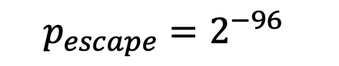
Mac security and collision detection
32-Byte secret key
== 0 ?
PTE-line
MAC
== ?
Line address
== ?
$$p_{escape}=2^{−96}$$
52-Byte SRAM
Collision Tracking Buffer
20-Bytes
PT-Guard protects all PTE cachelines and requires just 52-Bytes of SRAM
Notes:
We need ensure all PTE cachelines are protected with a MAC.
To identify PTE cachelines, we leverage the zeroed out bits in the PFN to perform a bit pattern match.
On DRAM writes, all lines that match the bit pattern are protected by embedding the computed MAC within the line.
This includes all PTE cachelines and some non-page table lines that happen to match this bit pattern.
We detect tampering by matching the computed MAC with the embedded MAC on DRAM reads during page table walks.
The chance of a tampered PTE line escaping detection is exceedingly low for our 96-bit MAC.
It would require a trillion years of continuous reads of faulty PTE lines to get one such escape event.
However, there is a chance that the bits in the line where MAC is embedded happen to match with the MAC computed over the line.
In this case, we track such colliding lines with small buffer to ensure we don’t erroneously remove MAC bits from such lines on DRAM reads.
Overall, we require 32 bytes of SRAM in the memory controller to store the secret key of our MAC cipher and 20-bytes for the 4-entry collision tracking buffer, for a negligible SRAM requirement of 52-Bytes.

Slide 14
Pt-guard in presence of bit-flips
Data line
Data line
PTE
No data
PT- Guard
Exception
…
PTE
Core
Cache
Memory Controller
OS
PT-Guard protects page tables without affecting security of other data against Rowhammer
Notes:
PT-Guard detects all bit flips on page table walks, and once tampering is detected, we forward this information to the core without sending any data, and the core notifies the OS via an exception.
Therefore, tampered page table data is never consumed, even speculatively.
Recall that some regular data lines that happen to match the bit pattern are also embedded with a MAC.
To remove the MAC for such lines, PT-Guard needs to perform a MAC verification on every DRAM read, which is our main source of performance overhead.
If tampering is detected on such non-page table lines, the MAC is not removed and corrupted data is forwarded, which is no different compared to the unprotected baseline.
Note that PT-Guard is a targeted defense for page tables and is not designed to protect data lines.

Slide 15
Evaluation methodology
Simulation: Full system gem5
Ubuntu 18.04 OS
In-order 3GHz x86-based core
2MB Last-level Cache
4GB DDR4 memory
64-entry L1 TLB, 8KB MMU cache
Applications:
SPEC2017 workloads
Graphc analytics benchmarks (GAP)
MAC
== ?
10-Cycle MAC delay
PT- Guard
Memory Controller
Verify MAC on DRAM reads
Notes:
We evaluate PT-Guard with gem5 simulations using SPEC2017 and graph analytics benchmarks.
We use an in-order x86-based core with 2MB LLC and 4GB DDR4 memory with a 64-entry L1 TLB and an 8KB MMU cache.
The key overheads of PT-Guard is the MAC delay latency of 10 cycles that is incurred on all DRAM reads to verify and remove the embedded MAC as needed.
Next, we look at the results.

Slide 16
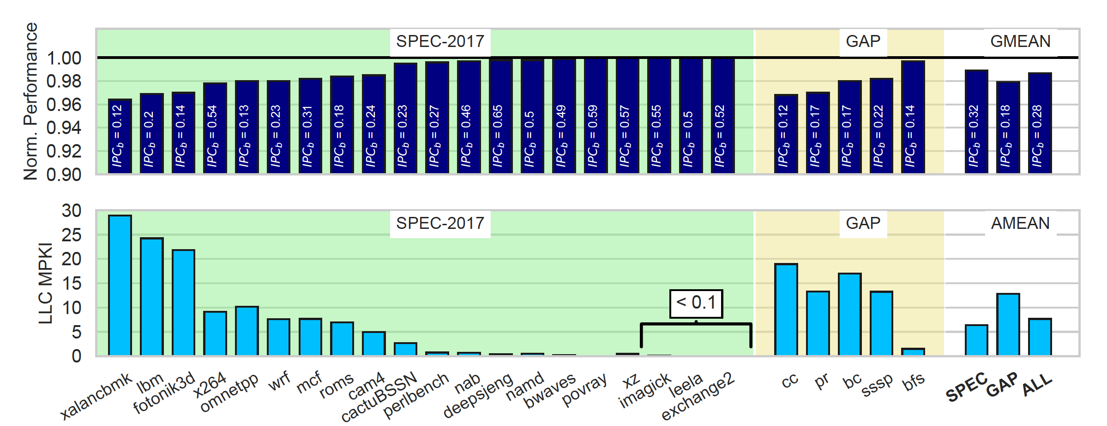
Evaluation results
PT-Guard provides complete security for page tables at a low average overhead of 1.3%
Notes:
Here, we show the normalized IPC of workloads with PT-Guard versus an unprotected baseline.
Overall, PT-Guard incurs a low overhead of 1.3% on average.
To understand these results, we plot the LLC misses per kilo instruction of these workloads and find that the slowdown is correlated with the LLC MPKI.
This is expected, as more cache misses leads to more DRAM accesses which leads to more delay for MAC verification.

Slide 17

Optimizations to reduce mac overheads
Slowdown
SRAM
$$≠$$
No Delay
1.3% → 0.3%
52-Bytes → 71-Bytes
== 0 ?
No Delay
== 0 ?
== 0 ?
Delay
PTE Line
MAC
Non-PTE Line
Identifier
MAC
== ?
DRAM Write
DRAM Read
Using identifier to avoid MAC delay and storing zero-MAC reduces overheads to 0.3%
Notes:
Now let us try to reduce these overheads. Note that the fraction of PTE cachelines is very small compared to all cachelines that are read from the DRAM.
Ideally, we would like to only incur MAC delay for PTE lines.
To achieve this, we embed a unique 56-bit randomly generated identifier with every line that matches an extended bit pattern of 152 bits on DRAM writes, compared to just 96 in the baseline PT-Guard.
These 56 bits are currently reserved and zeroed out by the OS, and we repurpose them to optimize PT-Guard.
On DRAM reads for regular data, we only verify the MAC if the identifier bits match, drastically reducing the number of lines that require a MAC verification.
As before, we remove the identifier and the MAC before forwarding the line to the cache.
Finally, we observe that many lines that are written back are zeroed out, so we pre-compute the MAC corresponding to all zeroes and keep it in the memory controller, further avoiding MAC computation and verification delay for zero-cachelines.
Overall, these optimization reduce the average slowdown due to PT-Guard to a negligible 0.3% without compromising on security and with just 19-Bytes of additional SRAM.

Slide 18
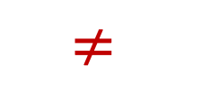
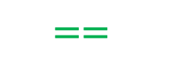
Pt-guard’s best effort error correction
Bit flip
Guess 2
1 0 1 0 1 1 1 0 1 1
Guess 1
1 1 1 0 0 1
0
1 0 0 0 1 1 1 0 0 1
1 0 1 0 1 1 1 0 1 1
$$≠$$
$$==$$
1 1 1 0 0 1
0 1 1 1 1 1
1 0 0 1 0 1
PT-Guard uses MAC’s integrity guarantee to reliably guess and correct faults in PTEs
Notes:
In addition to guaranteed detection of arbitrary PTE bit flips, PT-Guard optionally performs best-effort correction of bit flips.
We can correct with a very high confidence due to the key insight that if a correction causes the computed MAC to match with the embedded MAC, then it must be the correct value.
This is because a miscorrection is equivalent to a MAC collision, which has negligible probability.
So on page table walks, if an integrity failure occurs, PT-Guard tries multiple correction guesses for the PTE line, and if a guess succeeds, the fault is transparently corrected.
Now let’s see how we build error correction for PTEs using MAC.

Slide 19
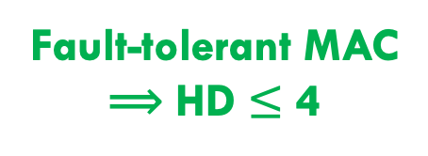
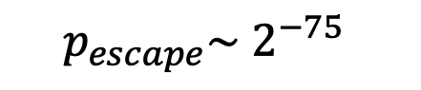
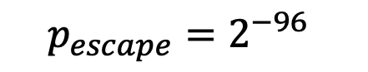
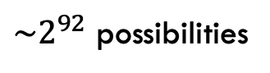
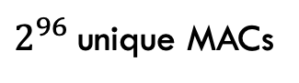
Building a fault tolerant mac
MAC | PFN | Metadata
1 1 1 … 0 0 1
$2^{96}$unique MACs
Bit flips in MAC
⟹ HD ~ 1
1 1 1 … 1 0 1
HD=1 MAC
96 possibilities
Exact-match MAC
1 possibility
$$p_{escape}=2^{−96}$$
Fault-tolerant MAC
⟹ HD $≤$ 4
HD=48 MAC
${\sim 2}^{92}$ possibilities
$$p_{escape}\sim 2^{−75}$$
Bit flips in data
⟹ HD >> 1
The fault-tolerant MAC tolerates up to 4 MAC bit flips with less than 1% uncorrectable errors
Notes:
Bit flips can occur in the embedded MAC itself, so even if the PTE value is correct, the computed and embedded MAC won’t match.
So we first design a fault tolerant MAC by observing that if a few bits flip in the MAC, then the hamming distance between the computed and stored MAC will also be small.
In contrast, flipping a few bits in the input to the MAC will results in approximately 50% of the bits being different in the resultant MAC, due to the avalanche effect of cryptographic ciphers, with a very high hamming distance.
Thus, if the computed and embedded MACs differ by only a few bits, we can safely use the guessed value with very high confidence.
We call this a soft-match of the MAC and use it for all our guesses.
We tolerate up-to 4 bit flips with our MAC, ensuring that uncorrectable errors due to 5 or more bit flips in the MAC itself, are below 1%.

Slide 20

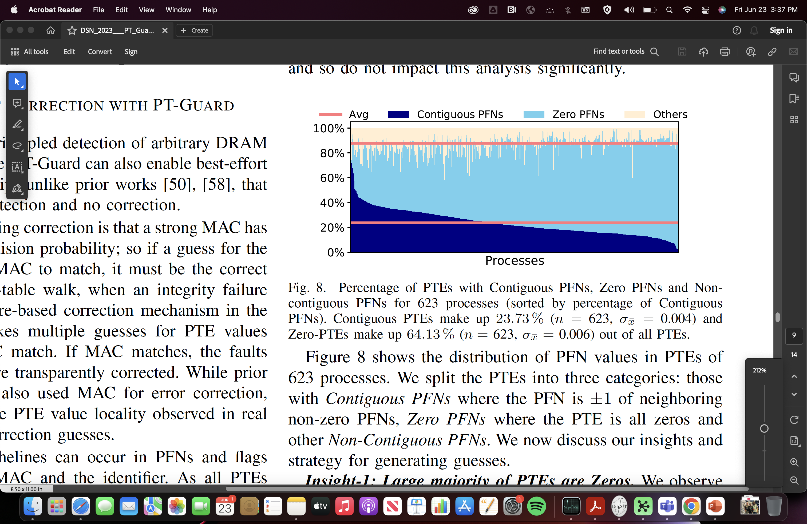
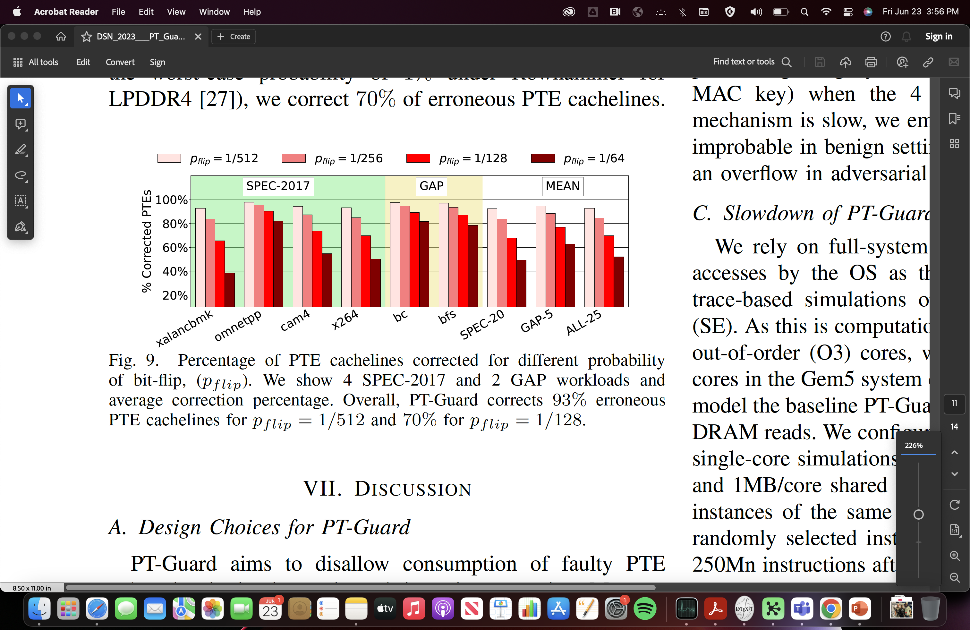
Real system insights to guess pte value
MAC | PFN | Metadata
① Reset almost-zero PTEs
② Enforce PFN contiguity
③ Majority vote for flags
PT-Guard corrects up to 93% of faulty PTEs transparently with no miscorrections
Notes:
With a fault-tolerant MAC, we can now try to guess PTE values.
We make informed guesses by analyzing real PTE cacheline data from 600+ processes from 2 systems and 24 million PTEs overall, as shown in the plot of processes and PTE behavior.
Correcting single bit errors is trivial as we can flip each bit and check if the MAC matches.
Next, we see a significant portion of PTEs are zeroed out, so if we observe almost-zero PTEs, we reset them to zero.
Finally, we observe contiguity within the PFNs and uniformity within the flags on the PTEs within a line and try to enforce these while guessing.
By combining all these guesses, we are able to correct 93% of all faulty PTEs in our simulations with a bit flip probability of 0.2% and 70% at a bit flip probability of 1%, which is close to the observed worst-case in LPDDR4.
By performing correction with a fault-tolerant MAC, we reduce the effective security of our 96-bit MAC.
We find the sweet spot where we can correct almost all errors while avoiding any miscorrection or escape.
Overall, PT-Guard with error correction still provides a MAC of an effective 66-bit security, which is good for 10,000 years of detecting faulty PTEs before one escapes.

Slide 21
Thank You
Pt-guard: conclusions
Breakthrough attacks routinely defeat new Rowhammer defenses
Imperative to safeguard page tables to avoid privilege escalation
PT-Guard provides cryptographic MAC-based integrity protection
PT-Guard protects all PTE fields from arbitrary tampering
No DRAM storage and access overhead, 71-Byte SRAM requirement
Optional error correction at best-effort leveraging system-level insights
Notes:
To conclude, breakthrough attacks continue to break supposedly secure Rowhammer mitigations that rely on heuristics like the Rowhammer threshold.
PT-Guard instead presents a dedicated solution to provide cryptographic integrity protection for page tables by embedding MAC within the PTE cache line.
Our approach has no DRAM storage and access overhead, is transparent to software, has a negligible SRAM overhead of less than 100 bytes, and provides security at virtually no performance cost.
Moreover, we also leverage real-system insights in PTE values to perform best-effort error correction, which is not possible with previous defenses.
Finally, PT-Guard also does not require any significant changes to the core and cache hierarchy, and is implemented at the memory controller.
Overall, we develop an ultra-low cost solution which reliably defends against the most severe Rowhammer exploit, which is page table tampering.

Slide 23
BACKUP SLIDES

